Slide 1
CSE1001- Introduction to Problem Solving and Programming

Slide 2
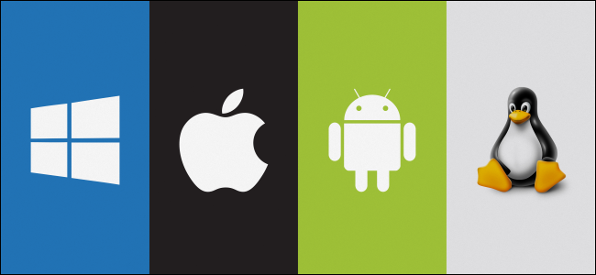
Overview of Operating systems

Slide 3
What is an Operating System?
A program that acts as an intermediary between a user of a computer and the computer hardware
Operating system goals:
Execute user programs and make solving user problems easier
Make the computer system convenient to use
Use the computer hardware in an efficient manner

Slide 4
Computer System Structure
Computer system can be divided into four components:
Hardware – provides basic computing resources
CPU, memory, I/O devices
Operating system
Controls and coordinates use of hardware among various applications and users

Slide 5
Computer System Structure
Application programs – define the ways in which the system resources are used to solve the computing problems of the users
Word processors, compilers, web browsers, database systems, video games
Users
People, machines, other computers

Slide 6
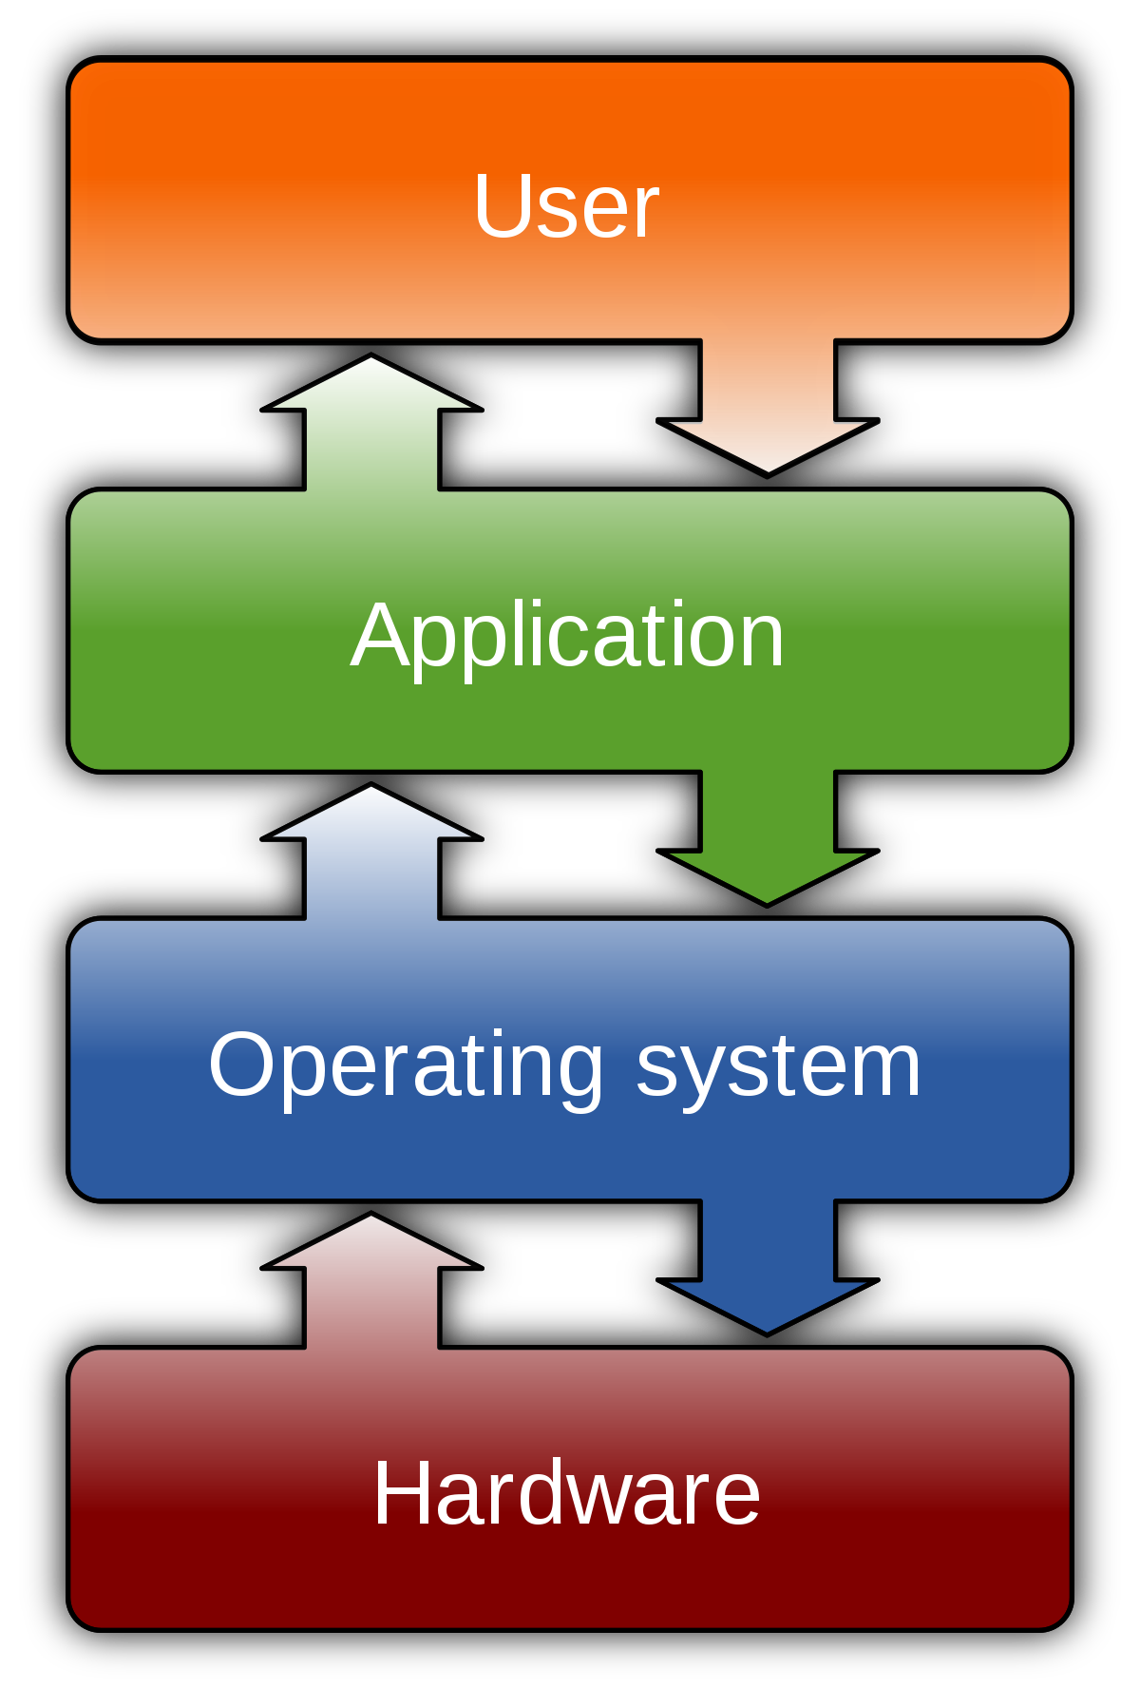

Slide 7
Operating System Definition
OS is a resource allocator
Manages all resources
Decides between conflicting requests for efficient and fair resource use
OS is a control program
Controls execution of programs to prevent errors and improper use of the computer

Slide 8
Computer Startup
bootstrap program is loaded at power-up or reboot
Typically stored in ROM or EPROM(erasable programmable read-only memory) , generally known as firmware
Initializes all aspects of system
Loads operating system kernel and starts execution

Slide 9
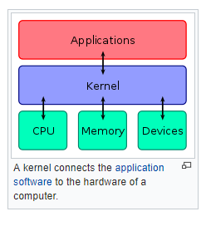
Kernel

Slide 10
Types of an Operating System
Batch operating system
The users of a batch operating system do not interact with the computer directly.
Each user prepares his job on an off-line device like punch cards and submits it to the computer operator.
To speed up processing, jobs with similar needs are batched together and run as a group.
The programmers leave their programs with the operator and the operator then sorts the programs with similar requirements into batches.

Slide 11
Time-sharing operating systems
Time-sharing is a technique which enables many people, located at various terminals, to use a particular computer system at the same time.
Time-sharing or multitasking is a logical extension of multiprogramming.
Processor's time which is shared among multiple users simultaneously is termed as time-sharing.

Slide 12
Time-sharing operating systems
The main difference between Multi programmed Batch Systems and Time-Sharing Systems is that in case of Multi programmed batch systems,
The objective is to maximize processor use, whereas in Time-Sharing Systems, the objective is to minimize response time.

Slide 13
Time-sharing operating systems
The time sharing system provides the direct access to a large number of users where CPU time is divided among all the users on scheduled basis.
The OS allocates a set of time to each user. When this time is expired, it passes control to the next user on the system.
The time allowed is extremely small and the users are given the impression that they each have their own CPU and they are the sole owner of the CPU.
This short period of time during that a user gets attention of the CPU; is known as a time slice or a quantum. The concept of time sharing system is shown in figure.

Slide 14
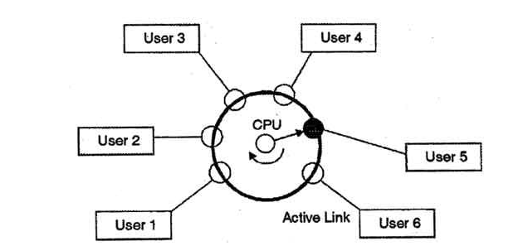

Slide 15
Network operating System
A Network Operating System runs on a server and provides the server the capability to manage data, users, groups, security, applications, and other networking functions.
The primary purpose of the network operating system is to allow shared file and printer access among multiple computers in a network, typically a local area network (LAN), a private network or to other networks.

Slide 16
Distributed operating System
Distributed Operating System is a model where distributed applications are running on multiple computers linked by communications.
A distributed operating system is an extension of the network operating system that supports higher levels of communication and integration of the machines on the network.
This system looks to its users like an ordinary centralized operating system but runs on multiple, independent central processing units (CPUs).

Slide 17
Compilers
A compiler is a program that reads a program written in one language –– the source language –– and translates it into an equivalent program in another language –– the target language
As an important part of this translation process, the compiler reports to its user the presence of errors in the source program

Slide 18
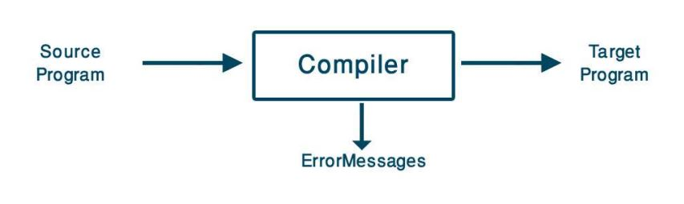
Compiler

Slide 19
What Do Compilers Do (1)
A compiler acts as a translator, transforming human-oriented programming languages into computer-oriented machine languages.
Ignore machine-dependent details for programmer
Programming
Language
(Source)
Machine
Language
(Target)
Compiler

Slide 20
What Do Compilers Do (2)
Compilers may generate three types of code:
Pure Machine Code
Machine instruction set without assuming the existence of any operating system or library.
Mostly being OS or embedded applications.
Augmented Machine Code
Code with OS routines and runtime support routines.
More often
Virtual Machine Code
Virtual instructions, can be run on any architecture with a virtual machine interpreter or a just-in-time compiler
Ex. Java

Slide 21
Compiler
At first glance, the variety of compilers may appear overwhelming.
There are thousands of source languages, ranging from traditional programming languages such as FORTRAN and Pascal to specialized languages.
Target languages are equally as varied.
A target language may be another programming language, or the machine language of any computer.

Slide 22
Compilers
Compilers are sometimes classified as:
single-pass
multi-pass
load-and-go
Debugging
optimizing

Slide 23
Compilers
Throughout the 1950’s, compilers were considered notoriously difficult programs to write.
The first FORTRAN compiler, for example, took 18 staff-years to implement

Slide 24
The Structure of a Compiler (1)
Any compiler must perform two major tasks
Analysis of the source program
Synthesis of a machine-language program
Compiler
Analysis
Synthesis

Slide 25
The Structure of a Compiler (2)
Source
Program
Scanner
Tokens
Parser
Syntactic
Semantic
Routines
(Character Stream)
Structure
Intermediate
Representation
Symbol and
Attribute
Tables
Optimizer
(Used by all Phases of The Compiler)
Code
Generator
Target machine code

Slide 26
The Structure of a Compiler (3)
Source
Program
Scanner
Tokens
Parser
Syntactic
Semantic
Routines
(Character Stream)
Structure
Intermediate
Representation
Scanner
The scanner begins the analysis of the source program by reading the input, character by character, and grouping characters into individual words and symbols (tokens)
RE ( Regular expression )
NFA ( Non-deterministic Finite Automata )
DFA ( Deterministic Finite Automata )
LEX
Symbol and
Attribute
Tables
Optimizer
(Used by all
Phases of
The Compiler)
Code
Generator
Target machine code

Slide 27
The Structure of a Compiler (4)
Source
Program
Scanner
Tokens
Parser
Syntactic
Semantic
Routines
(Character Stream)
Structure
Intermediate
Representation
Parser
Given a formal syntax specification (typically as a context-free grammar [CFG] ), the parse reads tokens and groups them into units as specified by the productions of the CFG being used.
As syntactic structure is recognized, the parser either calls corresponding semantic routines directly or builds a syntax tree.
CFG ( Context-Free Grammar )
BNF ( Backus-Naur Form )
GAA ( Grammar Analysis Algorithms )
LL, LR, SLR, LALR Parsers
YACC
Symbol and
Attribute
Tables
Optimizer
(Used by all
Phases of
The Compiler)
Code
Generator
Target machine code

Slide 28
The Structure of a Compiler (5)
Source
Program
Scanner
Tokens
Parser
Syntactic
Semantic
Routines
(Character Stream)
Structure
Intermediate
Representation
Semantic Routines
Perform two functions
Check the static semantics of each construct
Do the actual translation
The heart of a compiler
Syntax Directed Translation
Semantic Processing Techniques
IR (Intermediate Representation)
Symbol and
Attribute
Tables
Optimizer
(Used by all
Phases of
The Compiler)
Code
Generator
Target machine code

Slide 29
The Structure of a Compiler (6)
Source
Program
Scanner
Tokens
Parser
Syntactic
Semantic
Routines
(Character Stream)
Structure
Intermediate
Representation
Optimizer
The IR code generated by the semantic routines is analyzed and transformed into functionally equivalent but improved IR code
This phase can be very complex and slow
Peephole optimization
loop optimization, register allocation, code scheduling
Register and Temporary Management
Peephole Optimization
Symbol and
Attribute
Tables
Optimizer
(Used by all
Phases of
The Compiler)
Code
Generator
Target machine code

Slide 30
The Structure of a Compiler (7)
Source
Program
Scanner
Tokens
Parser
Syntactic
Semantic
Routines
(Character Stream)
Structure
Intermediate
Representation
Code Generator
Interpretive Code Generation
Generating Code from Tree/Dag
Grammar-Based Code Generator
Optimizer
Code
Generator
Target machine code

Slide 31
The Analysis-Synthesis Model of Compilation
There are two parts of compilation: –
Analysis
Synthesis
The analysis part breaks up the source program into constituent pieces
creates an intermediate representation of the source program
The synthesis part constructs the desired target program from the intermediate representation.

Slide 32
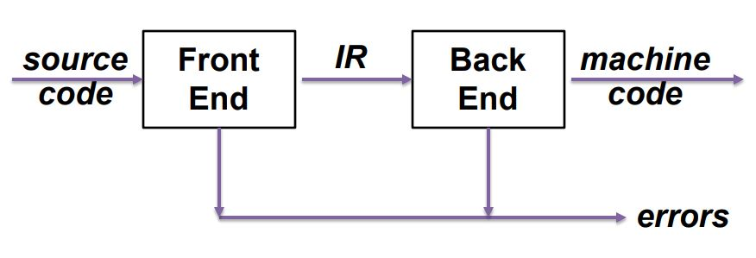
The Analysis-Synthesis Model of Compilation:

Slide 33
Interpreter
Programming languages are implemented in two ways: interpretation and compilation.
As the name suggests, an interpreter transforms or interprets a high-level programming code into code that can be understood by the machine (machine code) or into an intermediate language that can be easily executed as well.
The interpreter reads each statement of code and then converts or executes it directly.

Slide 34
Interpreter
interpretation happens per line or statement.
it can be stopped in the middle of execution to allow for either code modification or debugging

Slide 35
INTERPRETER | COMPILER
Translates program one statement at a time. | Scans the entire program and translates it as a whole into machine code
It takes less amount of time to analyse the source code but the overall execution time is slower. | It takes large amount of time to analyze the source code but the overall execution time is comparatively faster.
No intermediate object code is generated, hence are memory efficient. | Generates intermediate object code which further requires linking, hence requires more memory.
Continues translating the program until the first error is met, in which case it stops. Hence debugging is easy. | It generates the error message only after scanning the whole program. Hence debugging is comparatively hard.
Programming language like Python, Ruby use interpreters. | Programming language like C, C++ use compilers.

